Slide 1
Adversarial Robustness in the Streaming Model
Samson Zhou

Slide 2

Model #1: Streaming Model
Input: Elements of an underlying data set $S$, which arrives sequentially
Output: Evaluation (or approximation) of a given function
Goal: Use space sublinear in the size $m$of the input $S$
1 0 1 1 1 0 0 1
Notes:
Let’s start by breaking down each of the terms in the title. To understand the sliding window model, we first have to understand the streaming model of computation, in which elements of an underlying data set S, arrive sequentially and the goal is to evaluate or approximate some given function on this dataset, using space sublinear in S. In the sliding window model, only the W most recent updates form the underlying data set

Slide 3
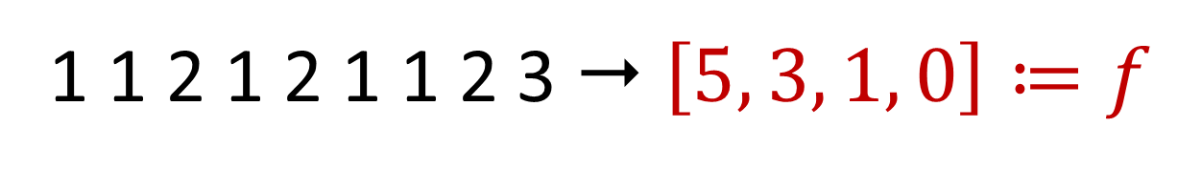

Heavy-Hitters
Given a set $S$ of $m$ elements from $[n]$, let $f_{i}$ be the frequency of element $i$. (How often it appears)
1 1 2 1 2 1 1 2 3  $\left[5, 3, 1, 0\right]≔f$

Slide 4
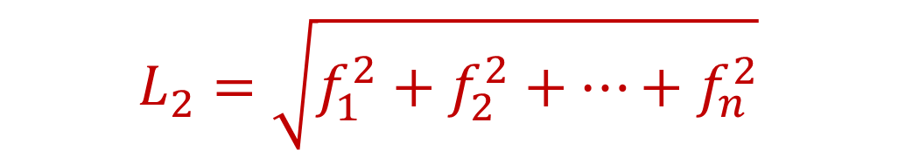
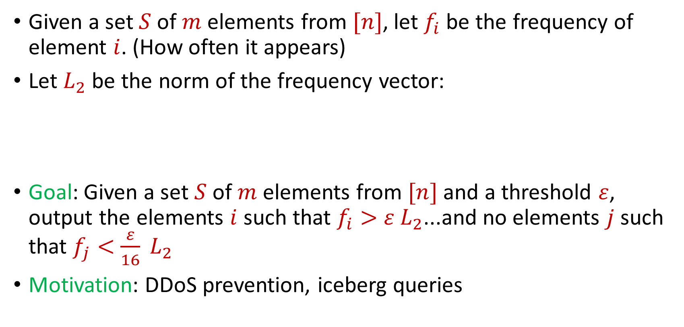
Heavy-Hitters
Given a set $S$ of $m$ elements from $[n]$, let $f_{i}$ be the frequency of element $i$. (How often it appears)
Let $L_{2}$ be the norm of the frequency vector:
Goal: Given a set $S$ of $m$ elements from $[n]$ and a threshold $ε$, output the elements $i$ such that $f_{i}>$ $ε L_{2}$...and no elements $j$ such that $f_{j}<$ $\frac{ε}{16} L_{2}$
Motivation: DDoS prevention, iceberg queries
$$L_{2}=\sqrt{f_{1}^{2}+f_{2}^{2}+…+f_{n}^{2}}$$

Slide 5
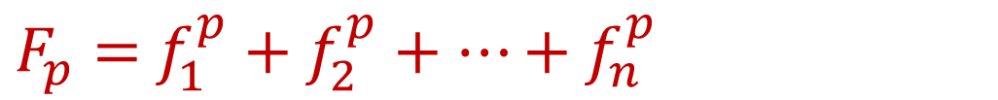
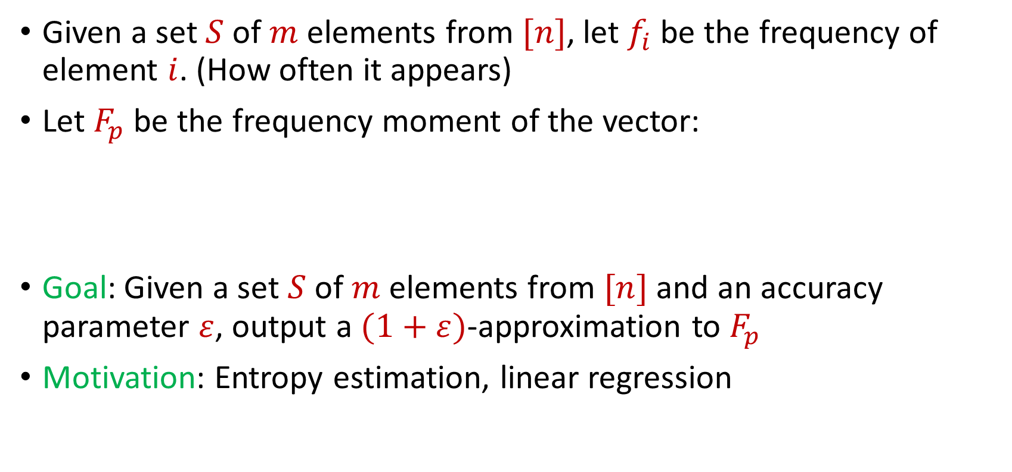
Frequency Moments
Given a set $S$ of $m$ elements from $[n]$, let $f_{i}$ be the frequency of element $i$. (How often it appears)
Let $F_{p}$ be the frequency moment of the vector:
Goal: Given a set $S$ of $m$ elements from $[n]$ and an accuracy parameter $ε$, output a $(1+ε)$-approximation to $F_{p}$
Motivation: Entropy estimation, linear regression
$F_{p}=$ $f_{1}^{p}+f_{2}^{p}+…+f_{n}^{p}$

Slide 6
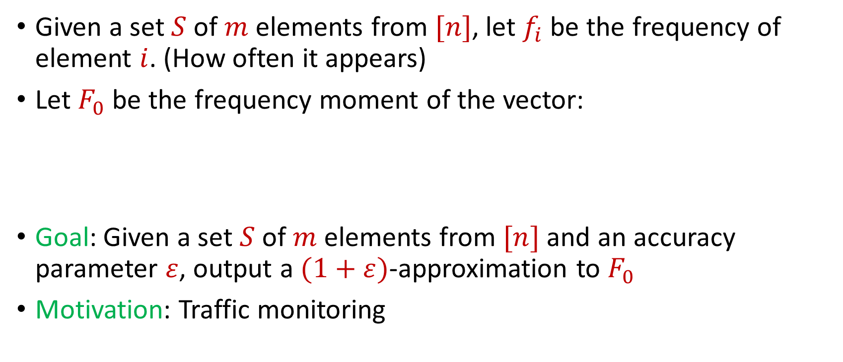
Distinct Elements
Given a set $S$ of $m$ elements from $[n]$, let $f_{i}$ be the frequency of element $i$. (How often it appears)
Let $F_{0}$ be the frequency moment of the vector:
Goal: Given a set $S$ of $m$ elements from $[n]$ and an accuracy parameter $ε$, output a $(1+ε)$-approximation to $F_{0}$
Motivation: Traffic monitoring
$F_{0}=$ $|\{i :f_{i}≠0\}|$

Slide 7
More generally…
Subspace embeddings, regression, low-rank approximation, clustering, etc.
(Can be handled by sampling algorithms)

Slide 8
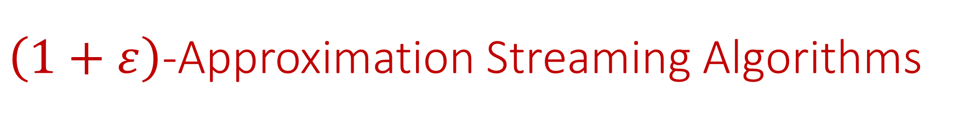
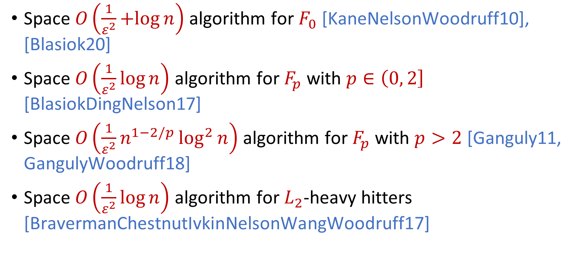
$\left(1+ε\right)$-Approximation Streaming Algorithms
Space $O\left(\frac{1}{ε^{2}}+log{n}\right)$ algorithm for $F_{0}$ [KaneNelsonWoodruff10], [Blasiok20]
Space $O\left(\frac{1}{ε^{2}}\log{n}\right)$ algorithm for $F_{p}$ with $p∈\left(0, 2\right]$ [BlasiokDingNelson17]
Space $O\left(\frac{1}{ε^{2}}n^{1−2/p}\log^{2}{n}\right)$ algorithm for $F_{p}$ with $p>2$ [Ganguly11, GangulyWoodruff18]
Space $O\left(\frac{1}{ε^{2}}\log{n}\right)$ algorithm for $L_{2}$-heavy hitters [BravermanChestnutIvkinNelsonWangWoodruff17]

Slide 9



Model #2: Adversarially Robust Streaming
Input: Elements of an underlying data set $S$, which arrives sequentially and adversarially
Output: Evaluation (or approximation) of a given function
Goal: Use space sublinear in the size $m$of the input $S$
1
1
Notes:
Let’s start by breaking down each of the terms in the title. To understand the sliding window model, we first have to understand the streaming model of computation, in which elements of an underlying data set S, arrive sequentially and the goal is to evaluate or approximate some given function on this dataset, using space sublinear in S. In the sliding window model, only the W most recent updates form the underlying data set

Slide 10
Model #2: Adversarially Robust Streaming
Input: Elements of an underlying data set $S$, which arrives sequentially and adversarially
Output: Evaluation (or approximation) of a given function
Goal: Use space sublinear in the size $m$of the input $S$
10
1
Notes:
Let’s start by breaking down each of the terms in the title. To understand the sliding window model, we first have to understand the streaming model of computation, in which elements of an underlying data set S, arrive sequentially and the goal is to evaluate or approximate some given function on this dataset, using space sublinear in S. In the sliding window model, only the W most recent updates form the underlying data set

Slide 11
Model #2: Adversarially Robust Streaming
Input: Elements of an underlying data set $S$, which arrives sequentially and adversarially
Output: Evaluation (or approximation) of a given function
Goal: Use space sublinear in the size $m$of the input $S$
101
2
Notes:
Let’s start by breaking down each of the terms in the title. To understand the sliding window model, we first have to understand the streaming model of computation, in which elements of an underlying data set S, arrive sequentially and the goal is to evaluate or approximate some given function on this dataset, using space sublinear in S. In the sliding window model, only the W most recent updates form the underlying data set

Slide 12
Model #2: Adversarially Robust Streaming
Input: Elements of an underlying data set $S$, which arrives sequentially and adversarially
Output: Evaluation (or approximation) of a given function
Goal: Use space sublinear in the size $m$of the input $S$
1010
3
Notes:
Let’s start by breaking down each of the terms in the title. To understand the sliding window model, we first have to understand the streaming model of computation, in which elements of an underlying data set S, arrive sequentially and the goal is to evaluate or approximate some given function on this dataset, using space sublinear in S. In the sliding window model, only the W most recent updates form the underlying data set

Slide 13

Model #2: Adversarially Robust Streaming
Input: Elements of an underlying data set $S$, which arrives sequentially and adversarially
Output: Evaluation (or approximation) of a given function
Goal: Use space sublinear in the size $m$of the input $S$
1010
3
Notes:
Let’s start by breaking down each of the terms in the title. To understand the sliding window model, we first have to understand the streaming model of computation, in which elements of an underlying data set S, arrive sequentially and the goal is to evaluate or approximate some given function on this dataset, using space sublinear in S. In the sliding window model, only the W most recent updates form the underlying data set

Slide 14
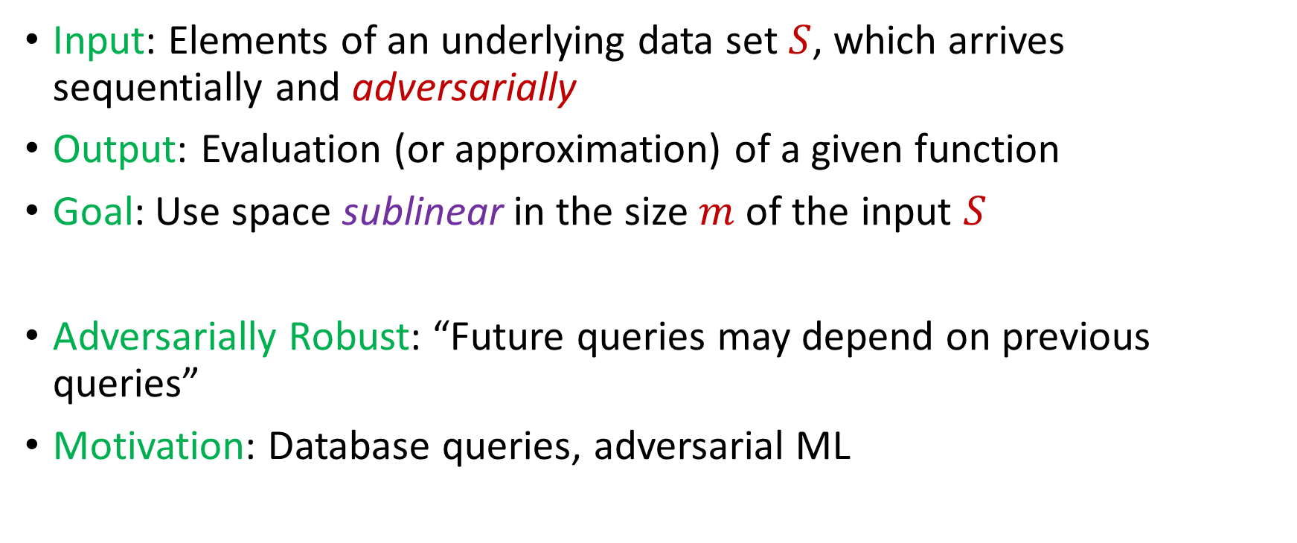
Model #2: Adversarially Robust Streaming
Input: Elements of an underlying data set $S$, which arrives sequentially and adversarially
Output: Evaluation (or approximation) of a given function
Goal: Use space sublinear in the size $m$of the input $S$
Adversarially Robust: “Future queries may depend on previous queries”
Motivation: Database queries, adversarial ML
Notes:
Let’s start by breaking down each of the terms in the title. To understand the sliding window model, we first have to understand the streaming model of computation, in which elements of an underlying data set S, arrive sequentially and the goal is to evaluate or approximate some given function on this dataset, using space sublinear in S. In the sliding window model, only the W most recent updates form the underlying data set

Slide 15
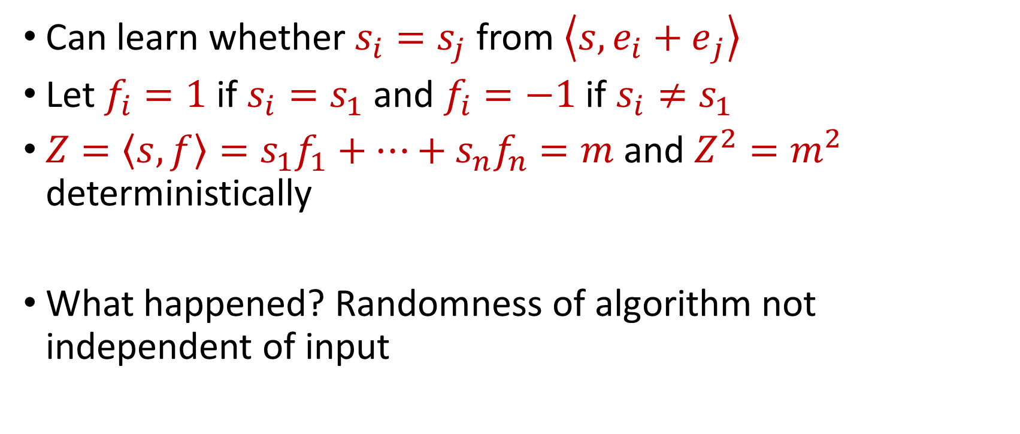
“Attack” on AMS
Can learn whether $s_{i}=s_{j}$ from $\left\langle s,{e_{i}+e}_{j}\right\rangle$
Let $f_{i}=1$ if $s_{i}=s_{1}$ and $f_{i}=−1$ if $s_{i}≠s_{1}$
$Z=\left\langle s,f\right\rangle =s_{1}f_{1}+…+s_{n}f_{n}=m$ and $Z^{2}=m^{2}$ deterministically
What happened? Randomness of algorithm not independent of input

Slide 16
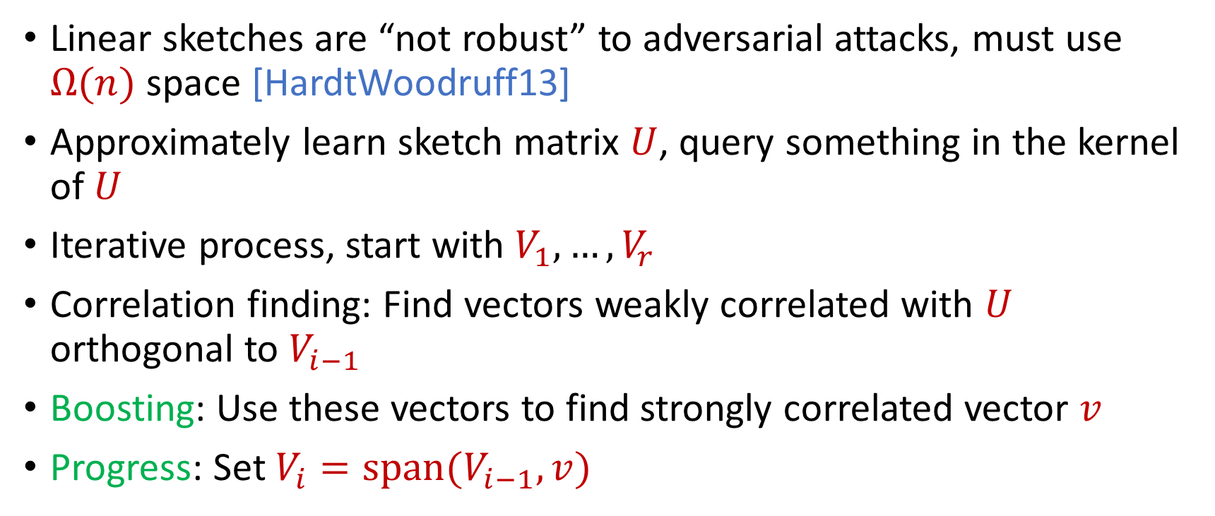
Reconstruction Attack on Linear Sketches
Linear sketches are “not robust” to adversarial attacks, must use $Ω(n)$ space [HardtWoodruff13]
Approximately learn sketch matrix $U$, query something in the kernel of $U$
Iterative process, start with $V_{1},…,V_{r}$
Correlation finding: Find vectors weakly correlated with $U$ orthogonal to $V_{i−1}$
Boosting: Use these vectors to find strongly correlated vector $v$
Progress: Set $V_{i}=span(V_{i−1},v)$

Slide 17
Insertion-Only Streams
Key: Deletions are needed to perform this attack
Assume insertion-only updates
How do the previous results work?

Slide 18
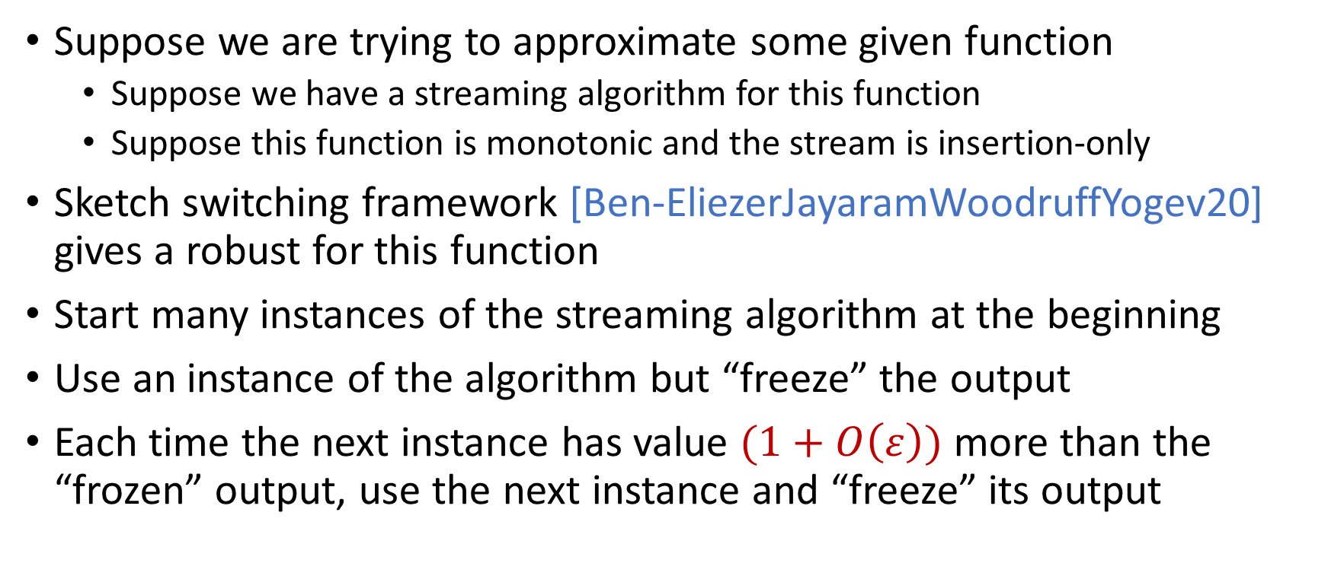
Robust Algorithms
Suppose we are trying to approximate some given function
Suppose we have a streaming algorithm for this function
Suppose this function is monotonic and the stream is insertion-only
Sketch switching framework [Ben-EliezerJayaramWoodruffYogev20] gives a robust for this function
Start many instances of the streaming algorithm at the beginning
Use an instance of the algorithm but “freeze” the output
Each time the next instance has value $(1+O\left(ε\right))$ more than the “frozen” output, use the next instance and “freeze” its output

Slide 19

Sketch Switching
Start many instances of the streaming algorithm at the beginning
Use an instance of the algorithm but “freeze” the output
Each time the next instance has value $(1+O\left(ε\right))$ more than the “frozen” output, use the next instance and “freeze” its output
1
Example: Number of ones in the stream (2-approximation)
1
1
1
1

Slide 20

Sketch Switching
Start many instances of the streaming algorithm at the beginning
Use an instance of the algorithm but “freeze” the output
Each time the next instance has value $(1+O\left(ε\right))$ more than the “frozen” output, use the next instance and “freeze” its output
1 0
Example: Number of ones in the stream (2-approximation)
1
1
1
1

Slide 21
Sketch Switching
Start many instances of the streaming algorithm at the beginning
Use an instance of the algorithm but “freeze” the output
Each time the next instance has value $(1+O\left(ε\right))$ more than the “frozen” output, use the next instance and “freeze” its output
1 0 1
Example: Number of ones in the stream (2-approximation)
1
2
2
2

Slide 22
Sketch Switching
Start many instances of the streaming algorithm at the beginning
Use an instance of the algorithm but “freeze” the output
Each time the next instance has value $(1+O\left(ε\right))$ more than the “frozen” output, use the next instance and “freeze” its output
1 0 1
Example: Number of ones in the stream (2-approximation)
1
2
2
2

Slide 23
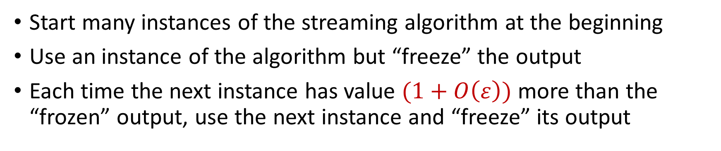
Sketch Switching
Start many instances of the streaming algorithm at the beginning
Use an instance of the algorithm but “freeze” the output
Each time the next instance has value $(1+O\left(ε\right))$ more than the “frozen” output, use the next instance and “freeze” its output
1 0 1 1
Example: Number of ones in the stream (2-approximation)
1
2
3
3

Slide 24
Sketch Switching
Start many instances of the streaming algorithm at the beginning
Use an instance of the algorithm but “freeze” the output
Each time the next instance has value $(1+O\left(ε\right))$ more than the “frozen” output, use the next instance and “freeze” its output
1 0 1 1 1
Example: Number of ones in the stream (2-approximation)
1
2
4
4

Slide 25
Sketch Switching
Start many instances of the streaming algorithm at the beginning
Use an instance of the algorithm but “freeze” the output
Each time the next instance has value $(1+O\left(ε\right))$ more than the “frozen” output, use the next instance and “freeze” its output
1 0 1 1 1
Example: Number of ones in the stream (2-approximation)
1
2
4
4

Slide 26
Sketch Switching
Start many instances of the streaming algorithm at the beginning
Use an instance of the algorithm but “freeze” the output
Each time the next instance has value $(1+O\left(ε\right))$ more than the “frozen” output, use the next instance and “freeze” its output
1 0 1 1 1 0 0 1 1 0 1
Example: Number of ones in the stream (2-approximation)
Number of ones stream is at least 4 and at most 8
4 is a good approximation
1
2
4
7

Slide 27
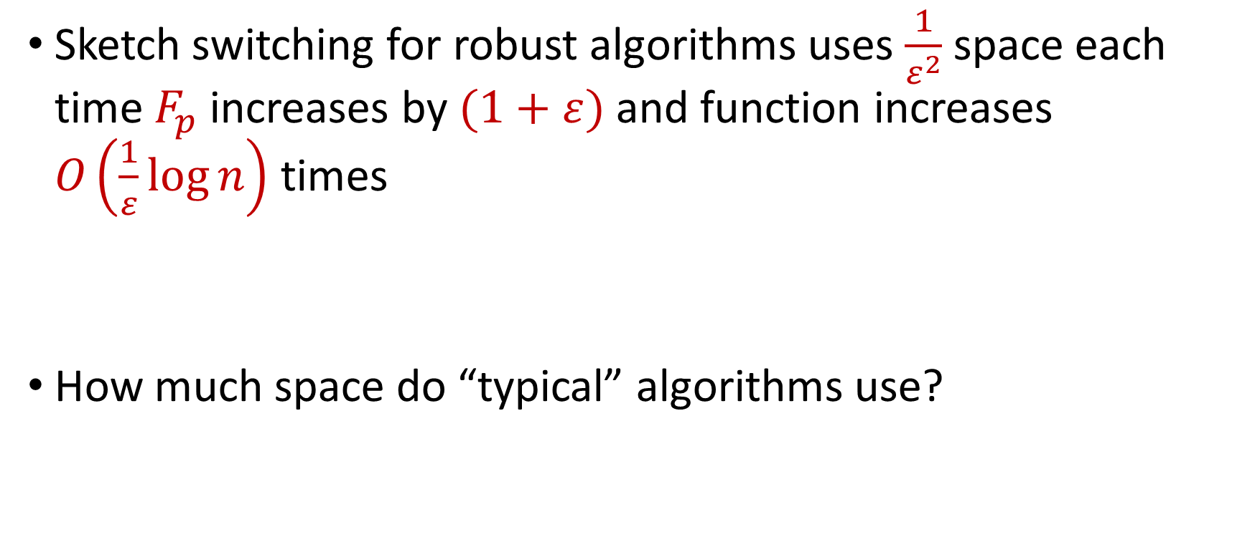
Sketch Switching Summary
Sketch switching for robust algorithms uses $\frac{1}{ε^{2}}$ space each time $F_{p}$ increases by $(1+ε)$ and function increases $O\left(\frac{1}{ε}\log{n}\right)$ times
How much space do “typical” algorithms use?

Slide 28
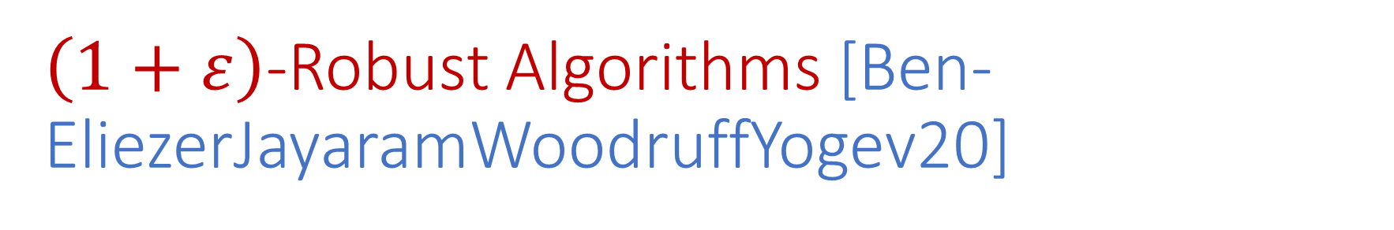
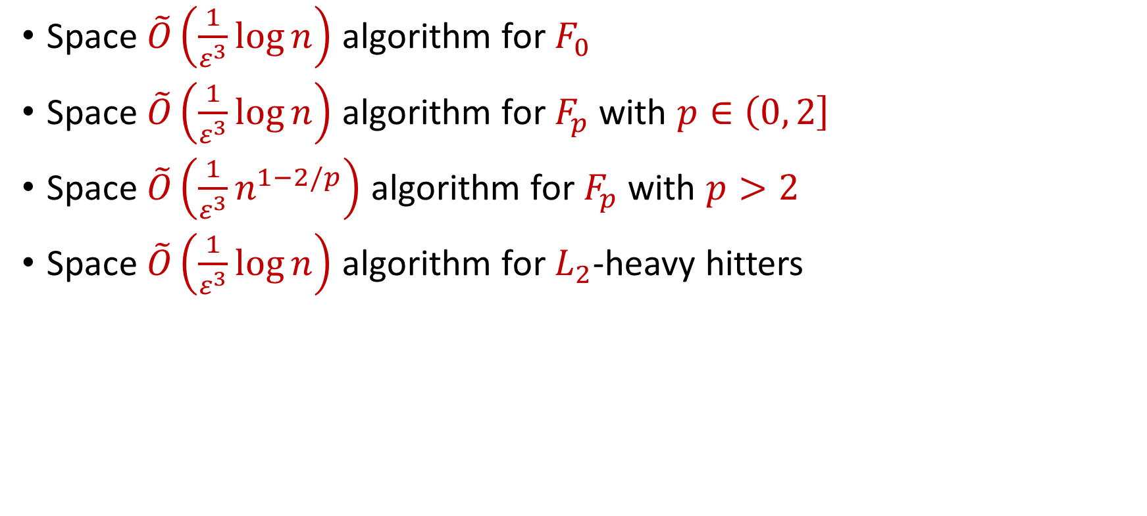
$\left(1+ε\right)$-Robust Algorithms [Ben-EliezerJayaramWoodruffYogev20]
Space $\tilde{O}\left(\frac{1}{ε^{3}}\log{n}\right)$ algorithm for $F_{0}$
Space $\tilde{O}\left(\frac{1}{ε^{3}}\log{n}\right)$ algorithm for $F_{p}$ with $p∈\left(0, 2\right]$
Space $\tilde{O}\left(\frac{1}{ε^{3}}n^{1−2/p}\right)$ algorithm for $F_{p}$ with $p>2$
Space $\tilde{O}\left(\frac{1}{ε^{3}}\log{n}\right)$ algorithm for $L_{2}$-heavy hitters
“A general framework that loses* nothing in $n$ and only $\frac{1}{ε}$ ”

Slide 29
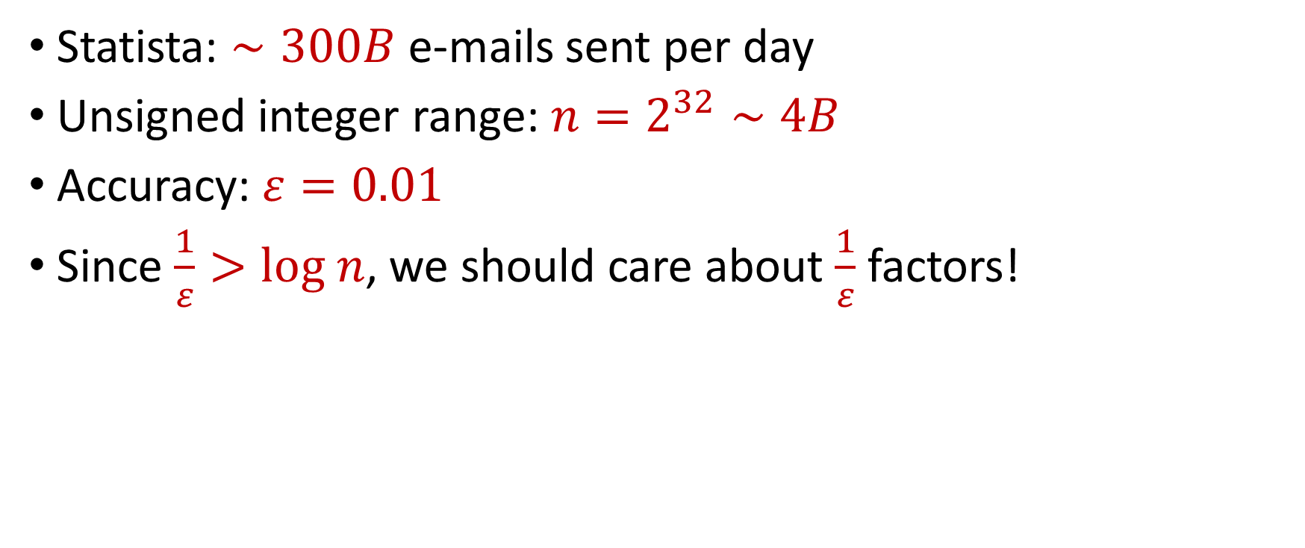
“What’s an epsilon between friends?
Statista: $∼300B$ e-mails sent per day
Unsigned integer range: $n=2^{32}∼4B$
Accuracy: $ε=0.01$
Since $\frac{1}{ε}>log n$, we should care about $\frac{1}{ε}$ factors!

Slide 30




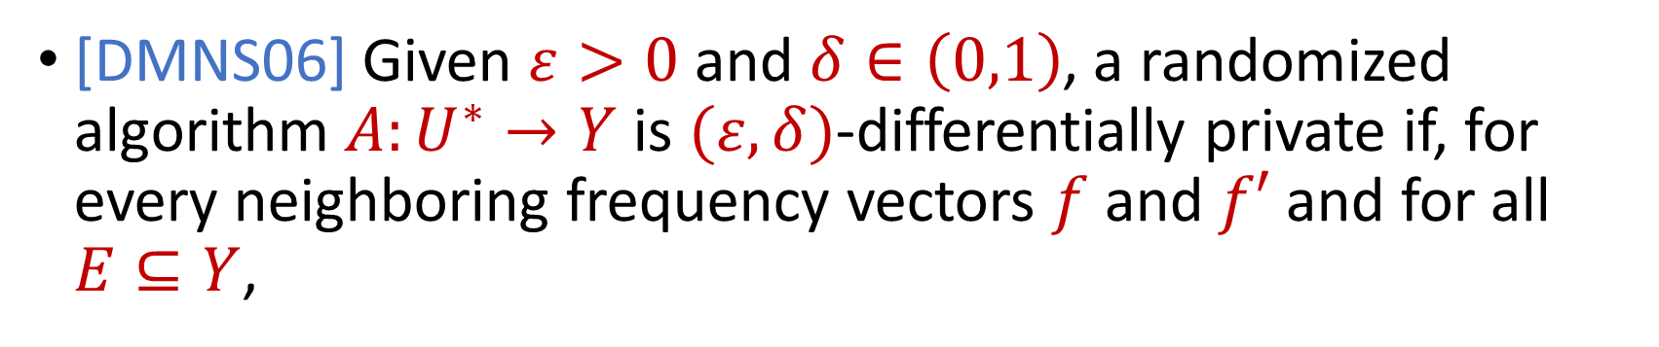

Differential Privacy
[DMNS06] Given $ε>0$and $δ∈\left(0,1\right)$, a randomized algorithm $A:U^{∗}→Y$ is $(ε,δ)$-differentially private if, for every neighboring frequency vectors $f$ and $f′$ and for all $E⊆Y$,
$$Pr\left[A\left(f\right)∈E\right]≤e^{ε}Pr\left[A\left(f^{′}\right)∈E\right]+δ$$
$$A\left( \right)≈A\left( \right)$$
Notes:
[DworkMcSherryNissimSmith06]

Slide 31
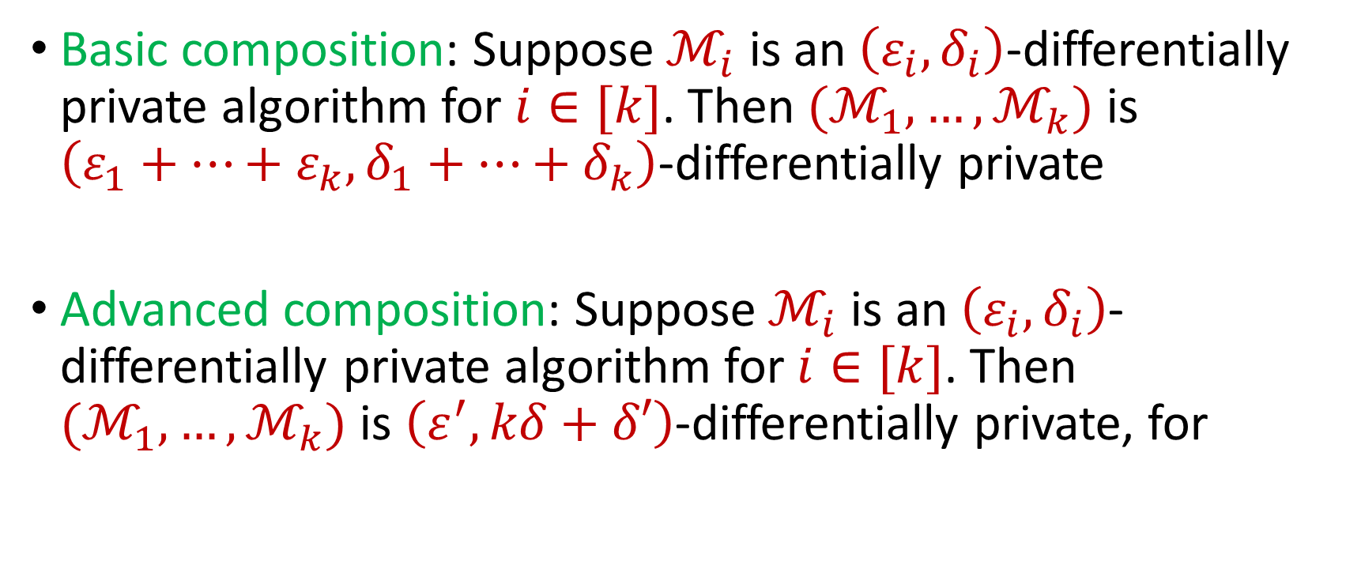
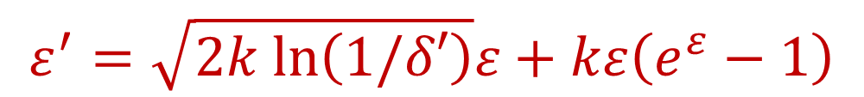
Composition Theorems
Basic composition: Suppose $ℳ_{i}$ is an $\left(ε_{i},δ_{i}\right)$-differentially private algorithm for $i∈[k]$. Then $(ℳ_{1},…,ℳ_{k})$ is $\left(ε_{1}+…+ε_{k},δ_{1}+…+δ_{k}\right)$-differentially private
Advanced composition: Suppose $ℳ_{i}$ is an $\left(ε_{i},δ_{i}\right)$-differentially private algorithm for $i∈[k]$. Then $(ℳ_{1},…,ℳ_{k})$ is $\left(ε^{′},kδ+δ′\right)$-differentially private, for
$$ε^{′}=\sqrt{2k ln\left(1/δ′\right)}ε+kε\left(e^{ε}−1\right)$$
Notes:
[DworkMcSherryNissimSmith06]

Slide 32
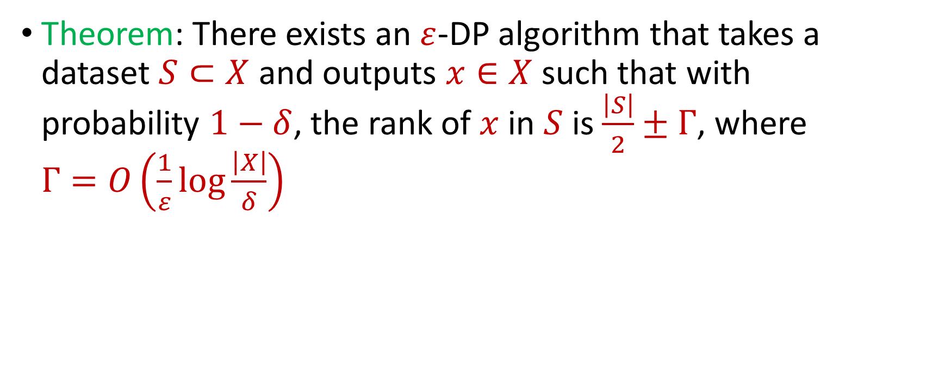
Private Median
Theorem: There exists an $ε$-DP algorithm that takes a dataset $S⊂X$ and outputs $x∈X$ such that with probability $1−δ$, the rank of $x$ in $S$ is $\frac{\left|S\right|}{2}±Γ$, where $Γ=O\left(\frac{1}{ε}\log{\frac{\left|X\right|}{δ}}\right)$
Notes:
[DworkMcSherryNissimSmith06]

Slide 33
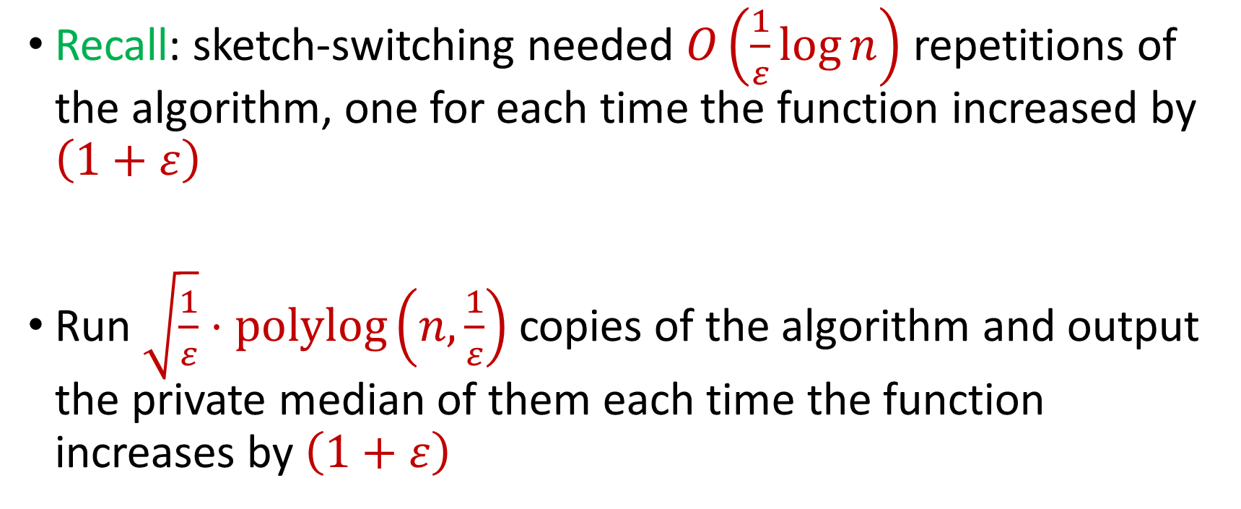
DP for Adversarial Robustness
Recall: sketch-switching needed $O\left(\frac{1}{ε}\log{n}\right)$ repetitions of the algorithm, one for each time the function increased by $\left(1+ε\right)$
Run $\sqrt{\frac{1}{ε}}⋅polylog\left(n,\frac{1}{ε}\right)$ copies of the algorithm and output the private median of them each time the function increases by $\left(1+ε\right)$
Notes:
[DworkMcSherryNissimSmith06]

Slide 34
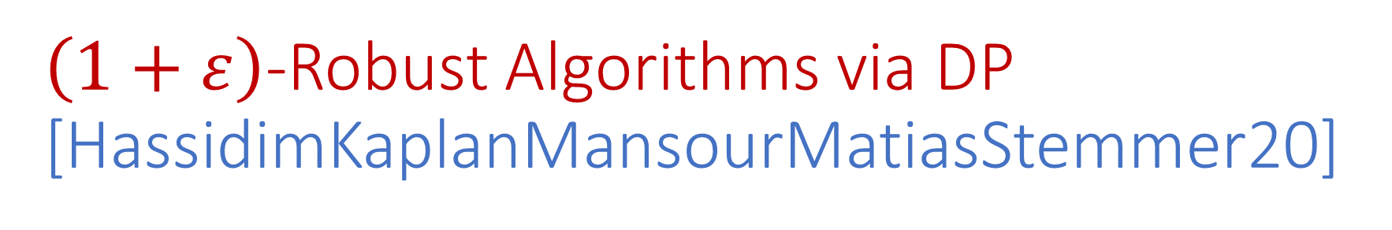
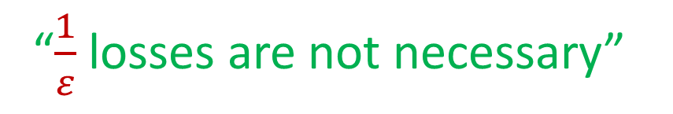
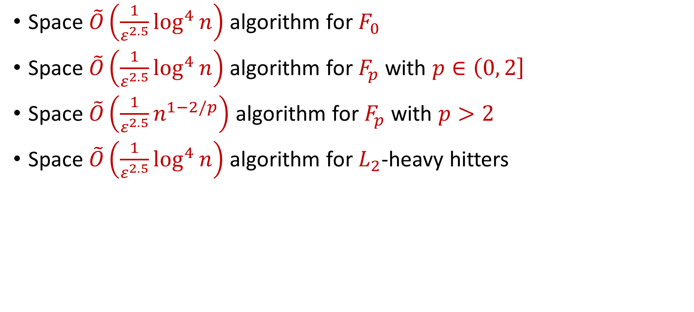
$\left(1+ε\right)$-Robust Algorithms via DP [HassidimKaplanMansourMatiasStemmer20]
Space $\tilde{O}\left(\frac{1}{ε^{2.5}}\log^{4}{n}\right)$ algorithm for $F_{0}$
Space $\tilde{O}\left(\frac{1}{ε^{2.5}}\log^{4}{n}\right)$ algorithm for $F_{p}$ with $p∈\left(0, 2\right]$
Space $\tilde{O}\left(\frac{1}{ε^{2.5}}n^{1−2/p}\right)$ algorithm for $F_{p}$ with $p>2$
Space $\tilde{O}\left(\frac{1}{ε^{2.5}}\log^{4}{n}\right)$ algorithm for $L_{2}$-heavy hitters
“$\frac{1}{ε}$ losses are not necessary”

Slide 35
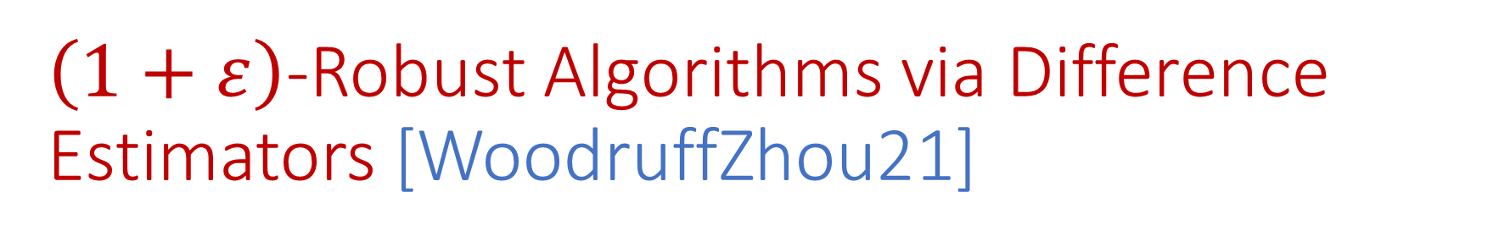
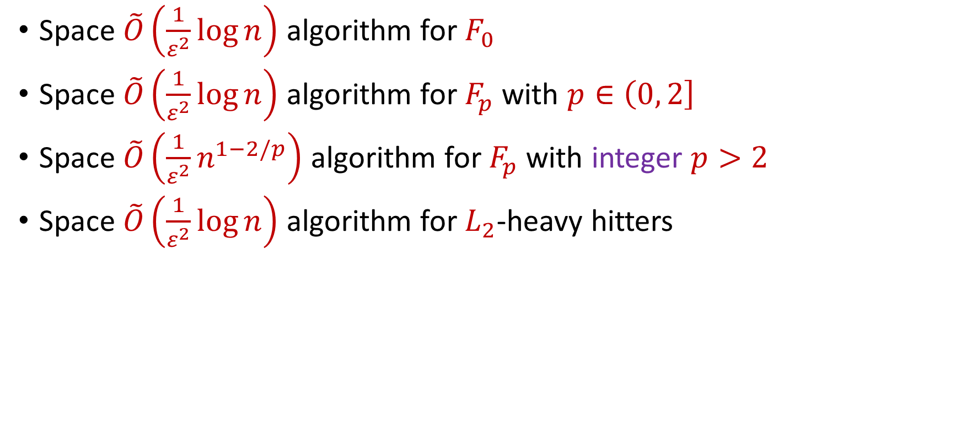
$\left(1+ε\right)$-Robust Algorithms via Difference Estimators [WoodruffZhou21]
Space $\tilde{O}\left(\frac{1}{ε^{2}}\log{n}\right)$ algorithm for $F_{0}$
Space $\tilde{O}\left(\frac{1}{ε^{2}}\log{n}\right)$ algorithm for $F_{p}$ with $p∈\left(0, 2\right]$
Space $\tilde{O}\left(\frac{1}{ε^{2}}n^{1−2/p}\right)$ algorithm for $F_{p}$ with integer $p>2$
Space $\tilde{O}\left(\frac{1}{ε^{2}}\log{n}\right)$ algorithm for $L_{2}$-heavy hitters
“No losses* are necessary!”

Slide 36


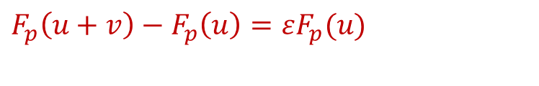




Difference Estimators Intuition
Do not need to pay $\frac{1}{ε^{2}}$ space each time $F_{p}$ increases by $(1+ε)$?
Only need constant factor approximation to $εF_{p}(u)$
Only need constant factor approximation to $F_{p}\left(u+v\right)−F_{p}\left(u\right)$
$F_{p}(u)$
Use difference estimator
$$u$$
$$u+v$$
$F_{p}\left(u+v\right)−F_{p}\left(u\right)=εF_{p}(u)$
$F_{p}(u+v)$
$$v$$

Slide 37
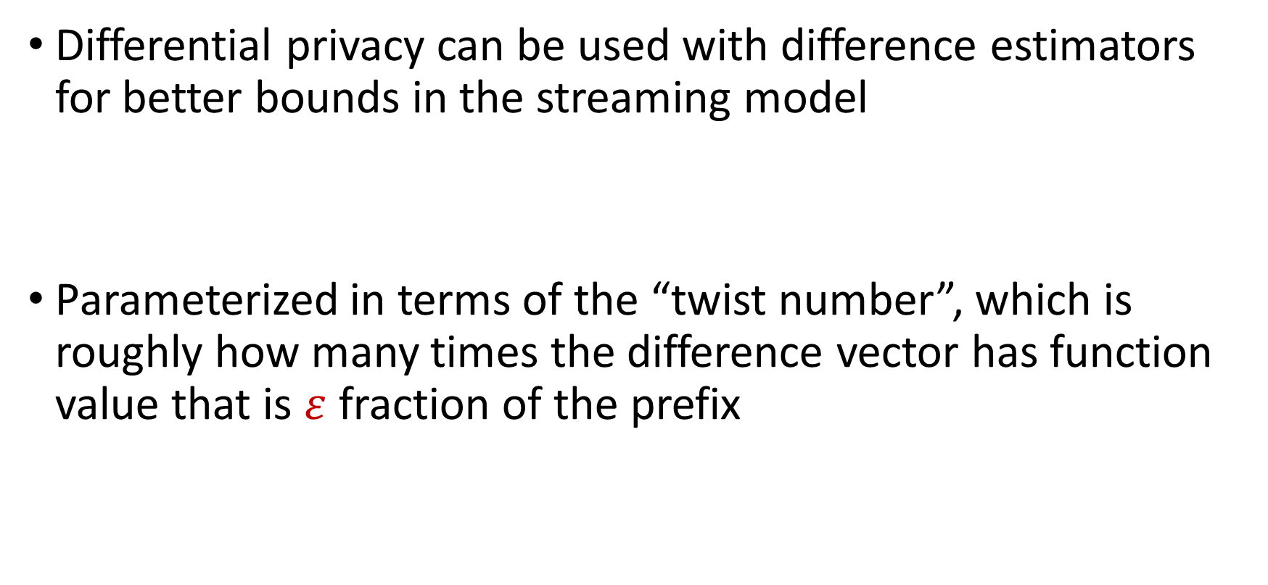
DP Strikes Back [AttiasCohenShechnerStemmer23]
Differential privacy can be used with difference estimators for better bounds in the streaming model
Parameterized in terms of the “twist number”, which is roughly how many times the difference vector has function value that is $ε$ fraction of the prefix

Slide 38
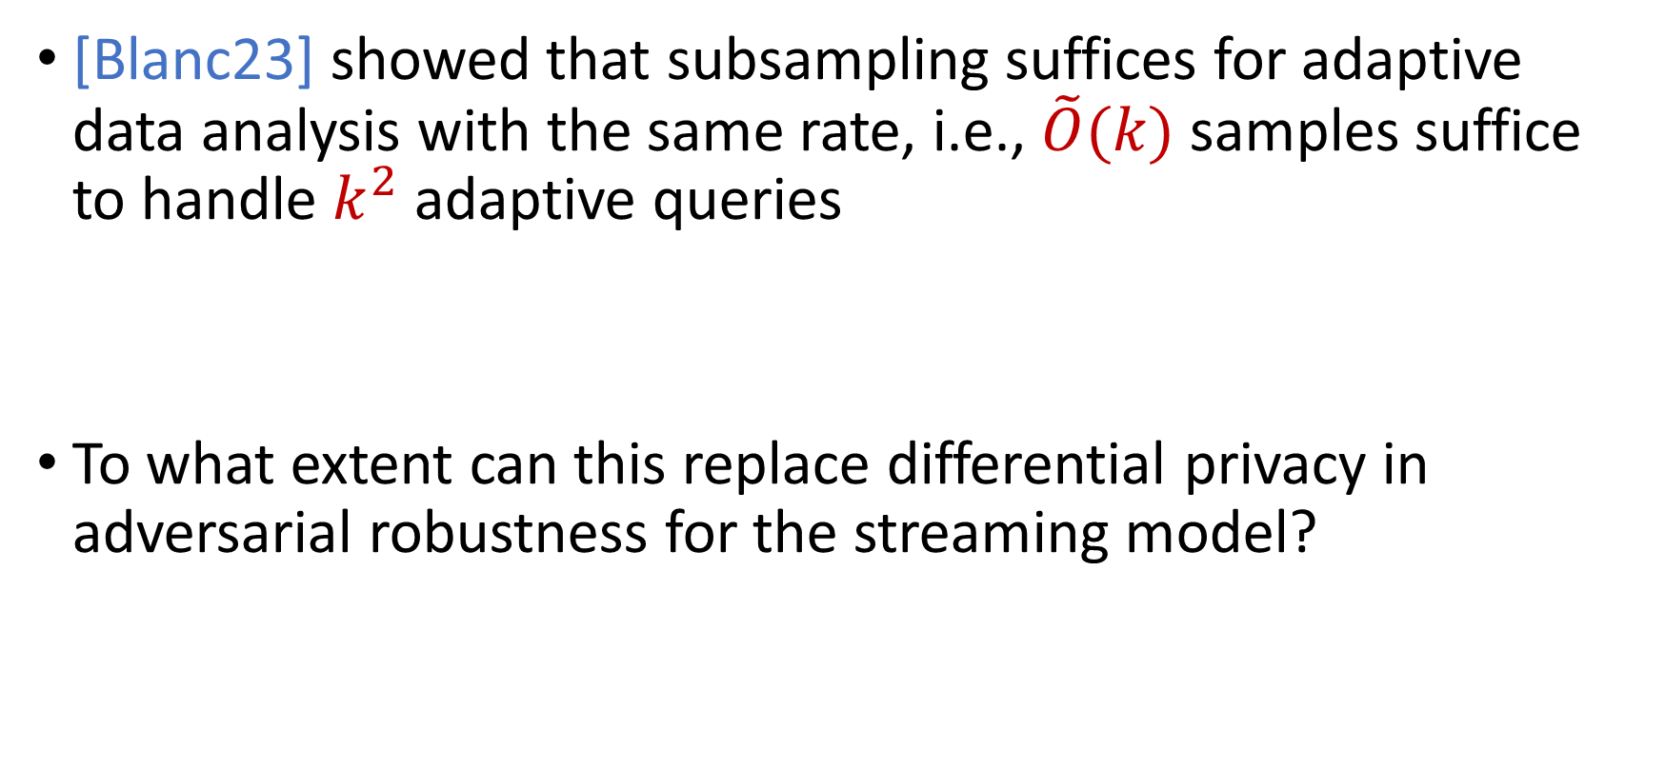
A Curious Question…
[Blanc23] showed that subsampling suffices for adaptive data analysis with the same rate, i.e., $\tilde{O}(k)$ samples suffice to handle $k^{2}$ adaptive queries
To what extent can this replace differential privacy in adversarial robustness for the streaming model?

Slide 39
White-Box Adversaries
The adversary has access not only to the previous outputs of the honest algorithm, but also to the entire internal state of the algorithm
Certain sampling algorithms are robust even to white-box adversaries [BravermanHassidimMattiasSchainSilwalZhou22]
Can use crypto against time-bounded white-box adversaries

Slide 40


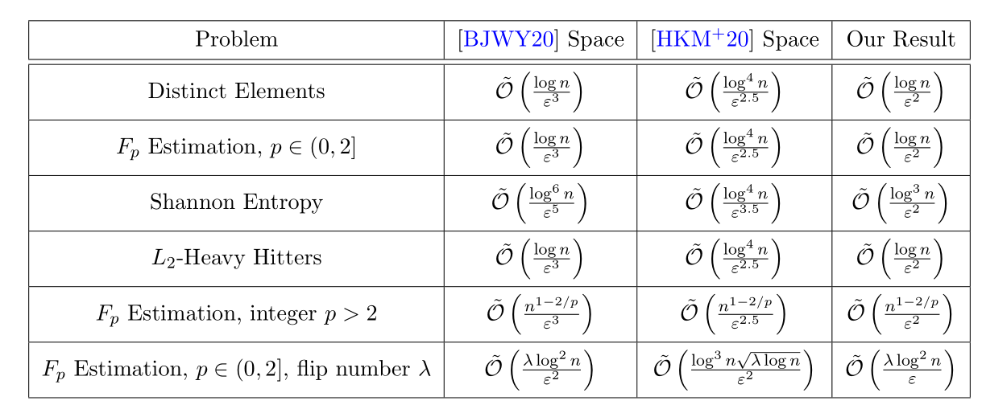
Summary

